Slide 1
Title of Project
ECP Biometric Voting System

Slide 2
Group Members
Muhammad Shoaib Rafique (2018-CS-78)
Muhammad Awais Ramzan (2018-CS-93)
Luqman Ali (2018-CS-95)

Slide 3
Prototype/Wireframe of Project

Slide 4
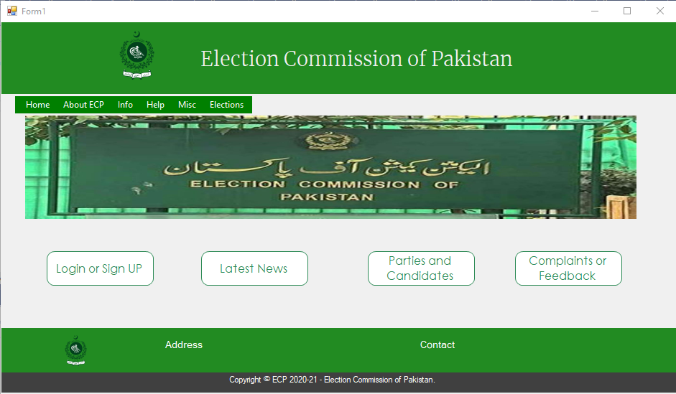

Slide 5
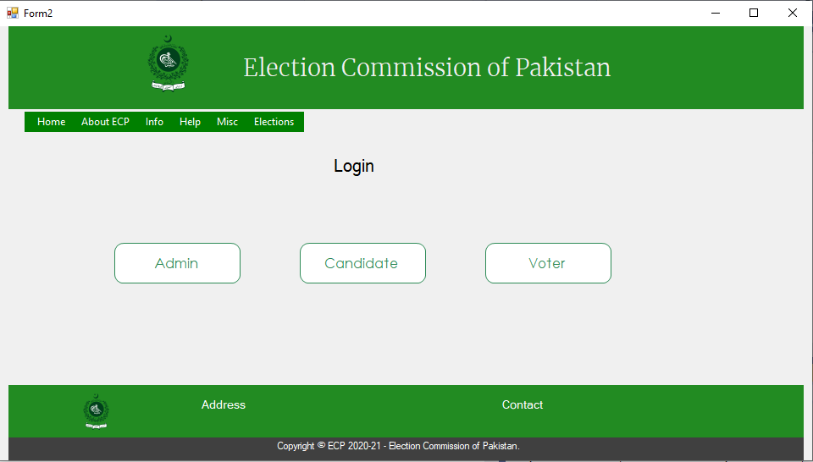

Slide 6
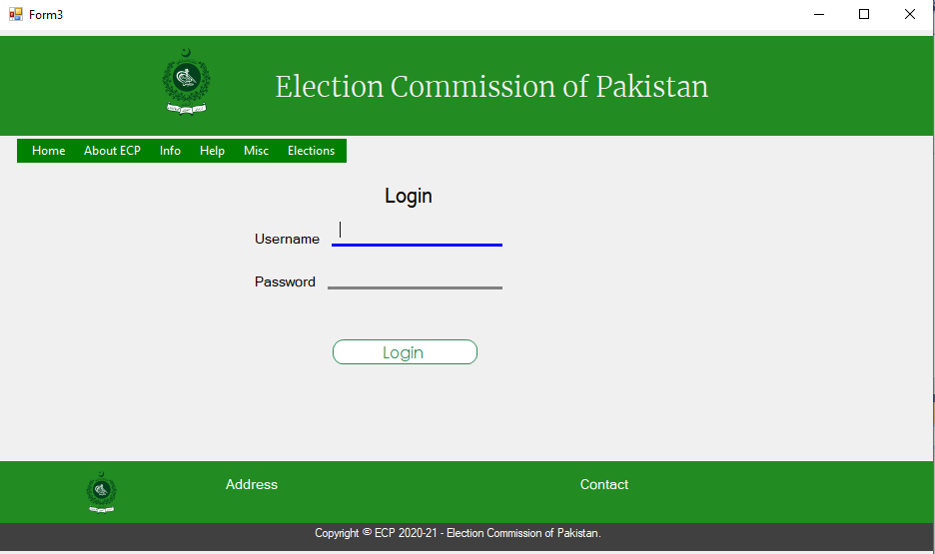

Slide 7
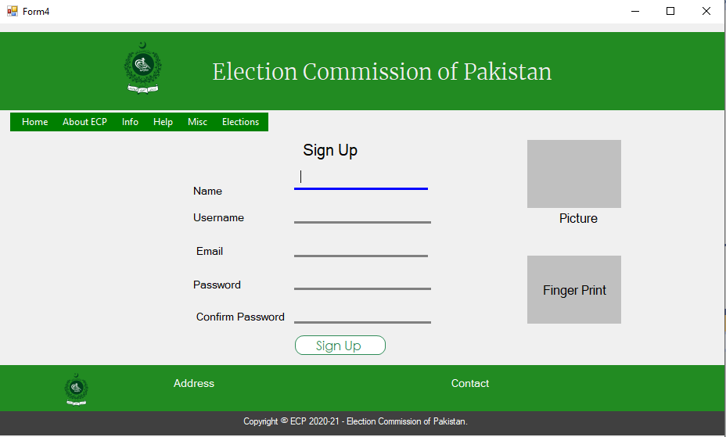

Slide 8
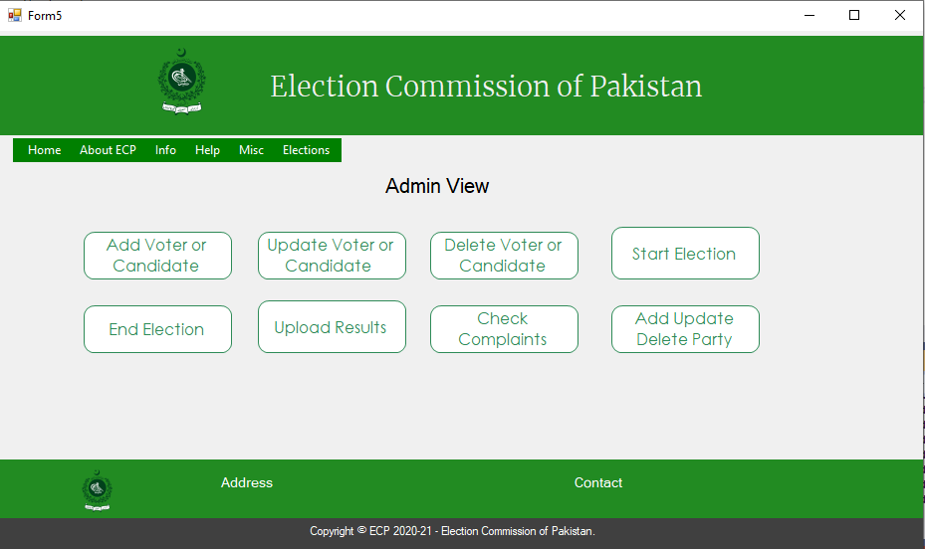

Slide 9
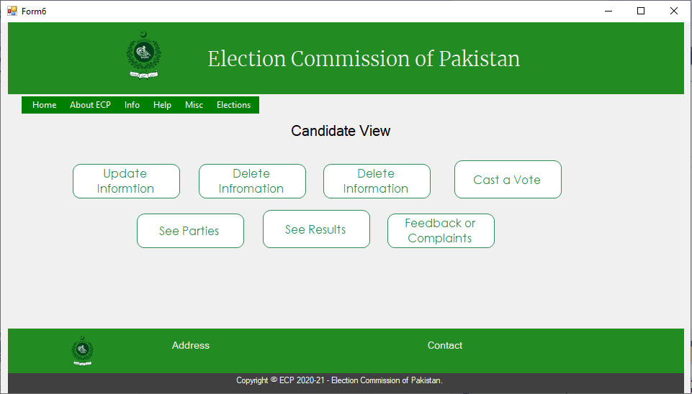

Slide 10
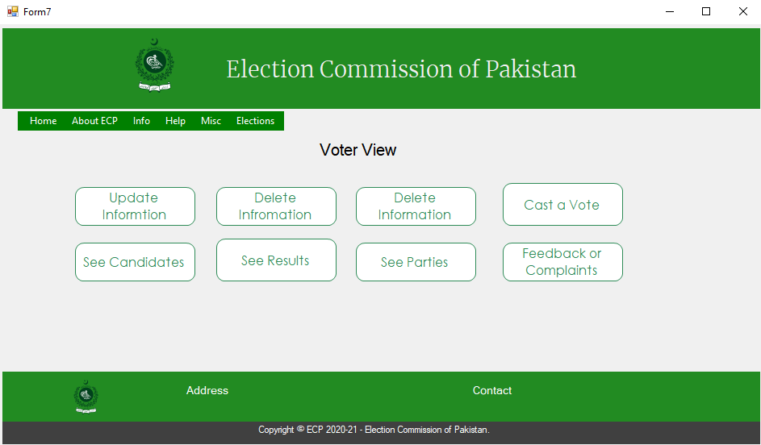

Slide 11
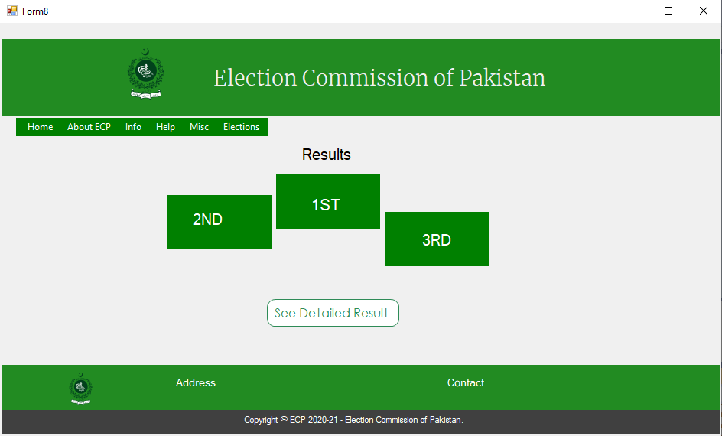

Slide 12
The End

